Slide 1
INTRODUCTION TO LANGUAGE TECHNOLOGIES
Prepared by:
1-Mohamed Yousri Ibraheem Abdallah. (ID: 20221509866)
2-Abdulrahman Salah Anwar Abdo. (ID: 20221458503)
3-Abu-Bakr Mohamed Mahmoud Ragab. (ID: 20221458962)
Topic Name: SENTIMENT ANALYSIS
Supervised By:
Prof. of Computational Linguistics and Head of Phonetics and Linguistics Dept.
Dr. Sameh Alansary
كلية الحاسبات و علوم البيانات

Slide 2



Team Members
كلية الحاسبات و علوم البيانات
الاسم: عبدالرحمن صلاح أنورعبده.
الرقم الجامعي: 20221458503
الرقم القومي: 30306250201075
الفرقة: الثانية
الاسم: محمد يسري إبراهيم عبدالله إبراهيم.
الرقم الجامعي: 20221509866
الرقم القومي: 30206150201294
الفرقة: الثانية
الاسم: أبوبكر محمد محمود رجب.
الرقم الجامعي: 20221458962
الرقم القومي: 30309130202093
الفرقة: الثانية

Slide 3
Description of sentiment analysis in text processing:
Sentiment analysis is a natural language processing technique that is used to determine the sentiment or emotion expressed in a piece of text, such as a tweet or a product review. The text is typically analyzed for the presence of positive, negative, or neutral words and phrases, and a sentiment score is assigned based on the overall sentiment of the text. The sentiment score can be represented numerically on a scale of -1 to 1, with -1 indicating a strong negative sentiment, 0 indicating a neutral sentiment, and 1 indicating a strong positive sentiment. Sentiment analysis can be used to gather feedback on products, services, or political candidates, and can also be used to monitor social media for sentiment around a particular topic or brand.

Slide 4
Definition of the problem:
Sentiment analysis is a natural language processing problem that determines the sentiment or emotional tone expressed in a piece of text. This can include determining if a statement is positive, negative, or neutral and identifying specific emotions such as happiness, anger, or sadness. The goal of sentiment analysis is to understand the writer's or speaker's attitudes, opinions, and emotions, and to gain insights into the overall sentiment toward a particular topic or brand. This problem is challenging due to the complexity and nuances of human language and the subjectivity of emotions. Additionally, sentiment analysis often involves dealing with noisy and unstructured data, such as social media posts, which can make it difficult to accurately identify sentiment.

Slide 5
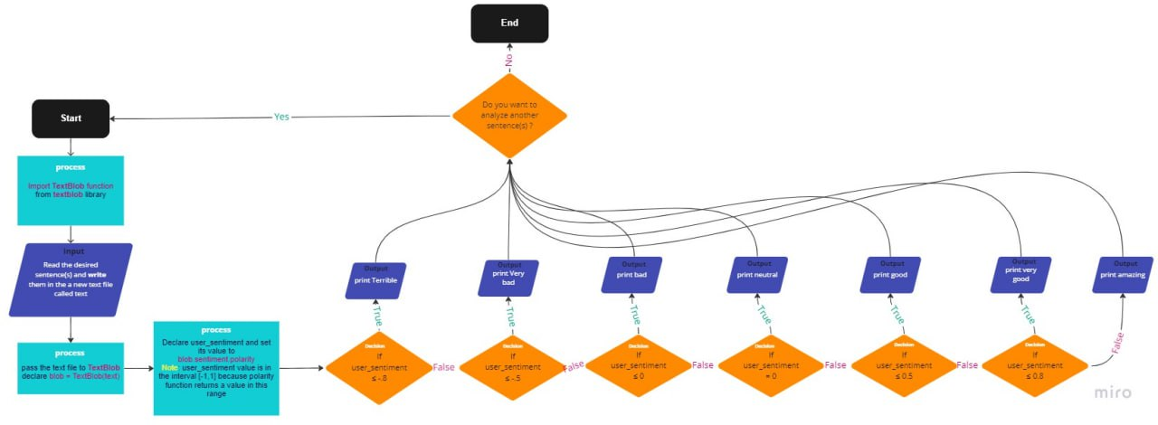
Flow chart

Slide 6
General steps involved in a sentiment analysis pipeline:
1. Data collection: Collecting a dataset of text data
2. Data preprocessing: Cleaning and preprocessing the collected data
3. Feature extraction: Extracting relevant features from the preprocessed data, such as the presence of certain words or phrases, which can be used to train a sentiment analysis model.
4. Model training: Training a machine learning model, such as a neural network or a support vector machine, on the extracted features to learn to predict the sentiment of the text.
5. Model evaluation: Evaluating the performance of the trained model using metrics such as accuracy, precision, recall, and F1-score.
6. Model deployment: Deploying the trained model in a production environment for real-time sentiment analysis.
7. Results interpretation: Interpreting the sentiment analysis results and drawing insights from the data.

Slide 7
Challenges (problems) that can be encountered when performing sentiment analysis:
1.Language complexity: Human language is complex and nuanced, which can make it difficult to accurately identify sentiment.
2.Subjectivity: Sentiment can be highly subjective, and different people may interpret the same text differently.
3.Data quality: Sentiment analysis often involves dealing with noisy and unstructured data, such as social media posts, which can make it difficult to accurately identify sentiment.
4. Data bias: Sentiment analysis models may suffer from bias if the dataset is not representative of the population or if the dataset is not balanced.
5. Limited context: Sentiment analysis models may not be able to consider the context of the text in order to understand the sentiment.
6.Scalability: Sentiment analysis models that are trained on a large dataset may not be able to scale to a real-time use case.
7. Multi-language support: Sentiment analysis models that are trained on one language may not be able to generalize to other languages.
8. Privacy and security: Sentiment analysis models may access sensitive data, therefore, it's important to implement proper security and privacy measures to protect the data.

Slide 8
Solutions:
To overcome these challenges, it's important to use a combination of techniques such as data preprocessing, feature extraction, and advanced machine learning models, as well as to evaluate the performance of the model using appropriate metrics and to interpret the results with caution.

Slide 9
Resources used:
A Comprehensive Guide to Sentiment Analysis: https://www.analyticsvidhya.com/blog/2018/07/hands-on-sentiment-analysis-dataset-python/
Sentiment Analysis with NLTK:
https://www.nltk.org/api/nltk.sentiment.html
It's important to note that the resources used will depend on the specific application and available data. It's also important to evaluate different resources, such as datasets and pre-trained models, to find the best fit for the task at hand.

Slide 10
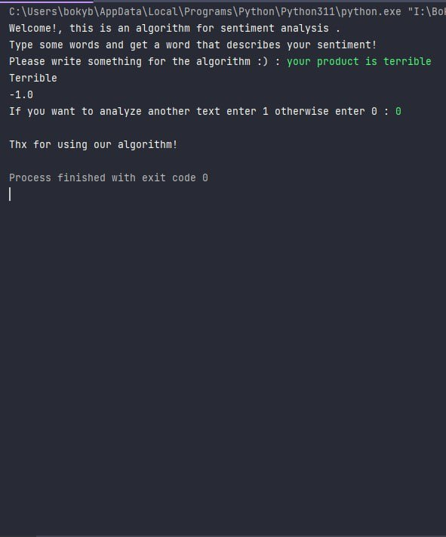
Example of the output:

Slide 11



